Slide 1
SALARY PREDICTOR KNOW YOUR WORTH
ANOUSHKA CHOUKSEY 0201CS171012
NIDHI RAGHUWANSHI 0201CS171046
PRANSHU MISHRA 0201CS171051

Slide 2
Background Information
Salaries are a complicated topic. In some cultures it's extremely impolite to ask someone how much they earn in a year. In other cultures it's a common topic of discussion you'd ask a friend or acquaintance. When looking for a job, it's a major deciding factor for many people. Sometimes the actual number is important, other times it's relative (“Am I being offered a salary that is below or above market?”).
Also , HR negotiators also need to quote an amount that isn’t too much or too less according to the job profile.
There are many sites like GlassDoor and PayScale that help us to do so.

Slide 3
The Problem
What is the problem?
To find the deserving salary for a job profile
Who has this problem?
HR Department
Why should this problem be solved?
To bring transparency between employees and employers

Slide 4
GIVEN SCENARIO
Well let's imagine the following scenario. We are an H R department and that we want to hire someone and we actually found someone that seems to be a great fit for the job. So we would like to offer this person a position in our company. And so this person says yes but at the end of the interview process comes the inevitable question “What is your salary expectation” and let's say that this person is you know very well advanced in its career and therefore that person is asking for one hundred and sixty thousand dollars per year and then also as H.R. negotiators we ask this person why are you expecting such a high salary and this person replies “Well that's because that's what I earned in my previous company. That was my salary in my previous company I earned one hundred and sixty thousand dollars per year so I am expecting at least one hundred and sixty thousand dollars per year in your company”.
Is that the truth or is that a bluff.

Slide 5
The DATASET
This data is actually the different salaries of a company for the different positions from business analyst to CEO.
In addition to this, other useful data are company size, industry, and company specialties.
Position | Level
Business Analyst | 1
Junior Consultant | 2
Senior Consultant | 3
Manager | 4
Country Manager | 5
Region Manager | 6
Partner | 7
Senior Partner | 8
C-level | 9
CEO | 10

Slide 6
Workable Solutions
Model #1
Model #2
Model #3
Polynomial Linear Regression
Support Vector Regression
Decision Trees

Slide 7
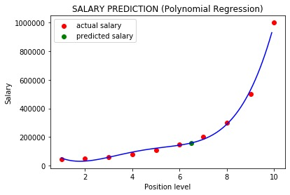
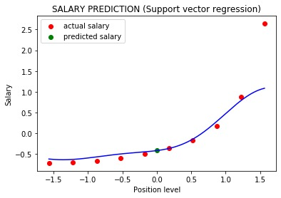
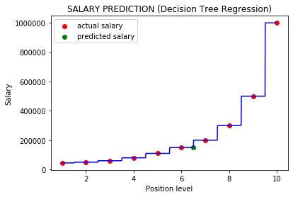
Testing The MODELS
$150,000 $131,106 $158,862

Slide 8
Final Result
We input a value of 6.5, as we were not sure if the candidate was a Region Manager(level 6) or Partner(level 7) in his previous firm.
In the final results, we see that Support Vector Regression (SVR) model predicts the value closest to the actual value.

Slide 9
Files attached
polynomial.ipynb – python file for polynomial linear regression model
supportvector.ipynb – python file for support vector regression
decision.ipynb – python file for decision tree regression
Position_Salaries - dataset
SALARY PREDICTOR – powerpoint presentation

